Slide 1
Supplier Satisfaction
Kevin Ast – April 2021

Slide 2
Respondents of the survey
Company
Modern Metals
IronScapes
Fusion Work
Weld Designed
Radical Steel
Myriad Metal Works
Advanced Assembly
Strong Designs
Cosmic Engineering
Number of Respondents | 10
Average Time to Complete Survey | 0:15:12
Notes:
These are the respondents that participated in the supplier satisfaction survey. There are 10 of them; they did not answer every question during this survey.
The average time taken to fill out each survey was around 15 minutes.
Strong Designs- Sebastian answered most of the questions, where Hans did not answer a lot of question. I believe Helmut was answering for the company. I consider the answers from Helmut to represent Strong Designs.
In total, we sent this survey out to 18 suppliers and 10 of them responded. That means 56% of the suppliers responded.
I will refer the respondents to their company name instead of their actual during the entire presentation.
I will refer every respondent to their company names during the presentation.
You can answer question anytime during the presentation, it will not be considered interrupting me.

Slide 3
Armour Valve Sales Partner Rating
The average rating was 3.9 / 5
Fusion Work and Modern Metals least satisfied
Cosmic Engineering and Weld Designed most satisfied
Notes:
(Q1) Overall, how would you rate Armour Valve as a sales partner? (check)
75% of respondents rated Armour Valve with either a 4 or 5 out of 5. The average rating being 3.9 / 5
Fusion Work(3) and Modern Metals(2) were the least satisfied; Weld Designed(5) and Cosmic Engineering (5) were satisfied.
I believe the average rating was quite skewed because there were only 8 respondents for this question.
The remaining respondents rated AV with a 4 out 5 rating. Strong Designs did not give us a rating.
Overall, our suppliers were happy with us. We should prioritize in improving our relationship with Fusion Work (3) and Modern Metals (2)

Slide 4
Top Performing Industries
Others:
Fusion Work: “Waste to Energy and Biomass”
Strong Designs: “Nuclear Power”
Notes:
(Q2) Please check your top performing industries.
Top industries appear to be Power Generation, Pulp & Paper, Oil & Gas and Water & Waste Water.
Others include :
Fusion Work - Waste to Energy and Biomass (part of Power)
Strong Designs- Nuclear Power

Slide 5
Top Performing Industries
Company | Alternative Fuels | Chemical Fertilizer | Consulting Engineering | District Energy | Metals & Mining | Oil & Gas | Petrochemical | Power Generation | Pulp & Paper Recycled Paper | Water & Waste Water
Modern Metals | X | X |  |  | X | X | X | X | X
IronScapes |  |  |  |  |  |  | X | X | X
Fusion Work |  |  |  |  |  |  |  | X | X | X
Weld Designed |  |  |  |  |  | X
Radical Steel |  |  |  |  |  |  |  |  | X
Myriad Metal WorksSystems |  | X | X | X |  | X | X | X | X | X
Advanced Assembly |  |  |  |  | X |  |  | X |  | X
Strong Designs | X |  |  | X |  | X |  |  |  | X
Cosmic Engineering |  | X |  |  |  | X |  | X
Notes:
This shows the top performing industries of our suppliers. These relate to the previous slide
Are there any surprises that jump at you?
Note: Strong Designs has 2 respondents that choose District Energy and their results were combined as they did not differ.

Slide 6
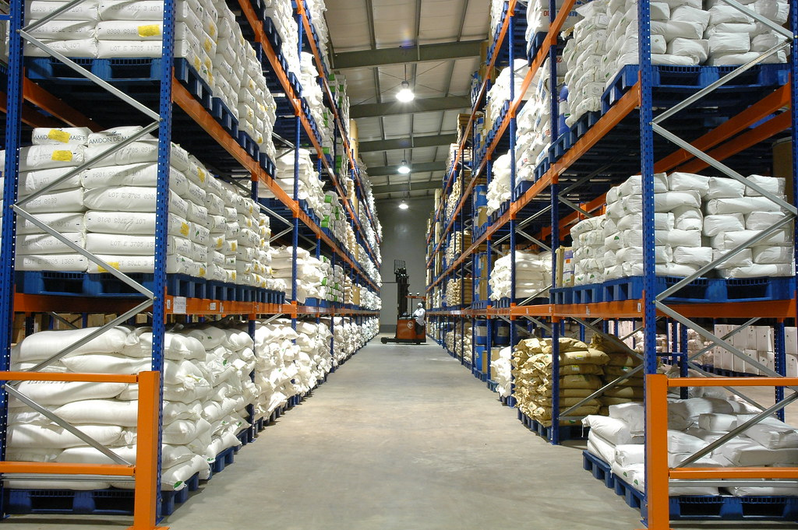
R&D initiatives or Sales & Marketing tools
2 of the respondents said Yes
2 of the respondents said No
A new warehouse
Magnetic Level Indicator
Product development & visual sales tools
New development manager
Notes:
(Q3) Are you undertaking any new R&D initiatives or developing any new sales & marketing tools? (check)
Modern Metals and Strong Designs responded with a yes
Radical Steel and Advanced Assembly responded with a no
Weld Designed is 2 to 3 months away from having a new warehouse
Myriad Metal Works is in the early stages of testing a “Magnetic Level indicator”
Cosmic Engineering said they working on product development and visual sales tools
Fusion Work has a new development Manager named Peter who will be working on things like this.
IronScapes did not respond.

Slide 7

Supplier Trend Preparation
Immediate focus on existing business
Continue pursuing growth in their primary markets
The decrease in thermal energy production – coal
Using greener and eco-friendlier energy & products
Saving Energy in production & using renewable Energy
Notes:
(Q4) What industry trends are you preparing for over the next 3-5 years? (check)
They will continue to pursue growth in their primary markets. -- Weld Designed– still focus on natural gas and maybe broadening their business in this segment as there is more growth there.
Currently, power is still important with the focus on flexibility -- fast start and stop-- Fusion Work
2. They are looking for solution for the thermal energy decrease by using less coal -- Cosmic Engineering
3. The respondents are preparing their businesses to be greener and eco-friendlier – Bi-fuel -- Modern Metals, Cosmic Engineering , Strong Designs
Saving energy and the use of renewable energy & products –
Strong designs , : Saving Energy could turn into Growth –
Cosmic Engineering – wants to use renewable energy

Slide 8
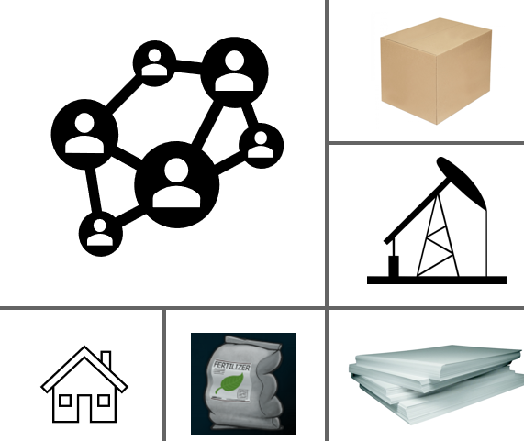
Supplier Trend Preparation
Sales, Industries & Communication
By growing oil and gas production.
Fertilizer Products
Focus on Pulp and Paper
Less out-sourcing; More in-house production
Improve virtual connections with representatives and End User
Notes:
4. Growing oil and gas production, (sales into that industry) -- Radical Steel
5. fertilizer production (sales into that industry) -- cosmic engineering
6. One of the respondents wanted to focus more on pulp and paper. -- Radical Steel
7. less outsourcing (or in-house production) -- Myriad Metal Works
improve virtual connections with representatives and End Users. - Myriad Metal Works
This can be improved by webinars; expand communication in this median
Advanced Assembly and IronScapes did not respond.

Slide 9
Business with Armour Valve is profitable
7 out of the 8 respondents agree with this statement
Fusion Work partly disagrees
Business with Armour Valve is profitable. | Count
Partly disagree | 1
Partly agree | 2
Fully agree | 5
Half of the Respondents rated AV as among the best or the best.
Fusion Work rated AV as among the worst.
Radical Steel rate AV average
Strong Designs and Cosmic Engineering rated among the best
How does Armour Valve compare to your best sales partner? | Count
Is among the worst | 1
Is average | 2
Is among the best | 2
Is the best | 1
Notes:
(Q5 – 7) Business with Armour Valve is profitable.
7 out of 8 respondents agree that Business with Armour Valve was profitable and
Two of them partly agreed (Modern Metals and Fusion Work). Fusion Work partly disagrees.
IronScapes is a new partner and say it is too early to tell. So they did not respond. Advanced Assembly did not respond as well.
We are among the best with partners Strong Designsand Conval.
We are an average partner to Radical Steel and Flo Tite.
Boehmer, Myriad Metal Works, Advanced Assemblyand IronScapesdid not give us a response.
Fusion Work stated AV is among the worst

Slide 10
Business with Armour Valve is profitable
Myriad Metal Works: “Efforts have improved”
Cosmic Engineering: “Capable personnel, great communications, hard working, technically strong, good territory coverage, a pleasure to deal with, “partner” mentality”
Strong Design: “Perfect cooperation “
Notes:
Myriad Metal Works has expressed that our efforts have continued to improve. We have been focusing more on “Myriad Metal Works” inquiries
Cosmic Engineering stated : Capable personnel, great communications, hard working, technically strong, good territory coverage, a pleasure to deal with, “partner” mentality
Strong Design sstated: Perfect cooperation

Slide 11
Payments are made on time
All 6 respondents fully agree that AV makes their payments on time.
Payments by Armour Valve are made on time. | Count
Fully agree | 6
4 of the respondents rates AV as either among the best or the best.
2 respondents rate AV average
How does Armour Valve compare to your best sales partner? | Count
Is average | 2
Is among the best | 3
Is the best | 1
Notes:
(Q8 – 10) Payments by Armour Valve are made on time.
1. IronScapes, Fusion Work, Radical Steel, Myriad Metal Works, Strong Designs and Cosmic Engineering fully agree that AV has made their payments on time.
IronScapes is new to us, and states it is too early to tell
Weld Designed doesn't know as the respondent hasn't seen anything but is sure the payments are on time. Advanced Assembly and Strong Designs did not respond.
2. 4 out of the 6 rates AV as either among the best or the best. – Fusion Work, Strong Designs(2),
Only 2 out of the 6 rates AV as average. -- radical steel and Radical Steel
Myriad Metal Works did not respond, but they stated “ We do not compare payments of one sales representative to another”
Weld Designed and Advanced Assembly did not respond
Note : Fusion work-- Strong sign given our past with them
Radical Steel --- we are average with them; we are focusing on them so we can expect better results in the future years

Slide 12
Armour Valve keeps their commitments
All 10 of the respondents agree that AV keeps their commitments
Myriad Metal Works stated: “Armour Valve represents a territory very different from the other sales representatives …”
Armour Valve keeps agreed commitments. | Count
Partly agree | 3
Fully agree | 7
7 out of 8 respondents rated AV as among the best or the best.
Radical Steel rated AV as average
IronScapes stated: “All signs are positive”
How does Armour Valve compare to your best sales partner? | Count
Is average | 1
Is among the best | 6
Is the best | 1
Notes:
(Q11 – 13) Armour Valve keeps agreed commitments.
All 10 of the respondents have agreed that AV does keep their commitments .
Myriad Metal Works stated : Armour Valve represents a territory very different from other sales representatives and therefore is not compared to others
7 out of the 8 think AV is among the best when keeping commitments. – Flo tite, QRC, Fusion Work, Troy, Strong Designs(2), Conval
Radical Steel has rated AV as average when keeping commitments.
Weld Designed and Myriad Metal Works did not respond.

Slide 13
Systematic forecasting of volumes
6 of the respondents believe systematic forecasting of volumes is important
Weld Designed states it is not important
Systematic forecasting of volumes. How important? | Count
Important | 4
Somewhat important | 2
Unimportant | 1
AV forecasting is considered average by 3 respondents
2 respondents rating it among the best.
Cosmic Engineering stated: “2020 was a tough year for everyone when it came to forecasting”
How does Armour Valve compare to your best sales partner? | Count
Is average | 3
Is among the best | 2
Notes:
(Q 14 – 16) Systematic forecasting of volumes.
6 of of the respondents agree that systematic forecasting is important; Weld Designedstates that it is not important
Advanced Assembly and Strong design did not respond
3 of the respondents (Weld, Fusion Work and Radical Steel) rate AV as average
2 of the respondents (Myriad, IronScapes) rate AV as one of the best
Boehmer, Advanced Assembly and Strong Designs did not respond
Cosmic Engineering stated : 2020 was a tough year for everyone when it came to forecasting.
Overall, AV forecasting is at least as good as the market average.

Slide 14
Clear long-term direction
6 out of 7 respondents find it is important overall.
Weld Designed found it somewhat important
Clear long term direction. | Count
Somewhat important | 1
Important | 3
Extremely important | 3
Three of the respondents find it average
Two of the respondents find AV to be among the best.
How does Armour Valve compare to your best sales partner? | Count
Is average | 3
Is among the best | 2
Notes:
(Q17 – 19) Clear long term direction.
6 out of 7 respondents find it important to have clear long term direction – Flo Tite, Fusion Work, Radical Steel, Myriad Metal Works, Fusion works
Weld Designed somewhat finds it important.
Strong Designs did not respond.
Fusion Work and Radical Steel consider AV average
Strong Designs and Cosmic Engineering rate AV among the best
Myriad Metal Works and Weld Designed did not respond.

Slide 15
Early Involvement in sales cycle for new opportunities
100% of the respondents find it important, either important or extremely important
Early involvement in the sales cycle for new opportunities. | Count
Important | 3
Extremely important | 4
3 of the respondents rated AV average
2 respondents rate AV among the best or the best.
How does Armour Valve compare to your best sales partner? | Count
Is average | 3
Is among the best | 1
Is the best | 1
Notes:
(Q 20 – 22) Early involvement in the sales cycle for new opportunities.
Myriad Metal Works, and Cosmic Engineering find it extremely important to be involved early in the sales cycle for new opportunities.
Fusion Work, and Radical Steel find it important to be involved early in the sales cycle for new opportunities.
IronScapes and Advanced Assembly did not respond.
3 of the respondents rated Armour Valve average --- Fusion Work, and Radical Steel,
2 of the respondents rated Armour Valve among the best or the best -- Strong Designs
Weld Designed and Advanced Assembly did not respond.

Slide 16
Clear contact and communication channel are available
All 6 respondents agree with this statement
Clear contact and communication channels are available. | Count
Partly agree | 2
Fully agree | 4
5 out of 6 respondents consider AV as one of the best or the best.
Radical Steel considers AV average.
How does Armour Valve compare to your best sales partner? | Count
Is average | 1
Is among the best | 4
Is the best | 1
Notes:
(Q 23 – 25) Clear contact and communication channels are available.
4 of the respondents, QRC, Fusion Work, Strong Designsand Cosmic Engineering partly agree.
Flo tite and Radical Steel fully agree with this statement.
Boehmer, Myriad Metal Works and Advanced Assemblydid not respond.
5 out of 6 respondents found Armour Vale to be among the best or the best.
Only Radical Steel found Armour Valve to be average.
Boehmer, Myriad Metal Works and Advanced Assemblydid not respond.

Slide 17
All necessary information is shared accordingly and thoroughly
All the respondents agree with this statement
All necessary information is shared accordingly and thoroughly. | Count
Fully agree | 6
Partly agree | 1
AV is considered among the best by 4 respondents; One considers AV the best
Only one respondent find AV to be average
How does Armour Valve compare to your best sales partner? | Count
Is average | 1
Is among the best | 4
Is the best | 1
Notes:
(Q 26 – 28) All necessary information is shared accordingly and thoroughly.
6 out of 7 fully agree that necessary information was shared accordingly and Thoroughly - Flo tite, QRC, Boehmer, Radical Steel, Strong Designsand Conval.
Only Fusion Work partly agrees;
Myriad Metal Works and Advanced Assemblydid not respond
Armour Valve is considered among the best or the best by 5 of the respondents. - QRC, Fusion Work, Brugg, Cosmic Engineering and Flo Tite
Radical Steel finds AV to be average.
Boehmer, Myriad Metal Works and Advanced Assemblydid not respond

Slide 18
Regular feedback from Armour Valve
The respondents gave us positive responses
4 respondents partly agree and 4 fully agree
We regularly receive feedback from Armour Valve. | Count
Partly agree | 4
Fully agree | 4
4 of the respondents rated AV as among the best to the best
2 of the respondents rated AV as average
How does Armour Valve compare to your best sales partner? | Count
Is among the best | 3
Is the best | 1
Is average | 2
Notes:
(Q 29 – 31) We regularly receive feedback from Armour Valve.
Half of the respondents partly agree - Fusion Work, Radical Steel
Other half of respondents fully agree - Strong Design and Cosmic Engineering
Myriad Metal Works did not respond.
4 of the Respondents find AV is either among the best or the best - Strong Designs and Cosmic Engineering
Fusion Work and Radical Steel find AV to be average among the competitors.
Boehmer, Myriad Metal Works and Advanced Assembly did not respond.

Slide 19
Where AV provides sufficient feedback
Which of the following areas do we provide sufficient feedback on? | Count
Product Quality | 2
Delivery Accuracy | 4
Lead Time | 4
Pricing | 4
Delivery Accuracy, Lead time and Pricing were chosen 4 times from the 5 respondents
Product Quality was chosen twice from the 5 respondents.
Notes:
(Q 32 – 33) Which of the following areas do we provide sufficient feedback on?
Radical Steel, Myriad Metal Works and Advanced Assembly have either not responded or did not receive sufficient feedback on Product Quality, Delivery Accuracy, Lead Time and Pricing.
Fusion works stated that they were provided sufficient feedback on Delivery Accuracy, Lead Time and Pricing.
IronScapes stated that they were provided sufficient feedback on Pricing
Strong Designs stated that they were provided sufficient feedback on Product Quality, Delivery Accuracy, Lead Time and Pricing.
Fusion Work stated that they were provided sufficient feedback on Delivery Accuracy, Lead Time.
Cosmic Engineering stated that they were provided sufficient feedback on Product Quality, Delivery Accuracy, Lead Time and Pricing.

Slide 20
Where AV provides sufficient feedback
Company | Product Quality | Delivery Accuracy | Lead Time | Pricing
Modern Metals |  | X | X | X
IronScapes |  |  |  | X
Fusion Work |  | X | X
Strong Designs | X | X | X | X
Cosmic Engineering | X | X | X | X
Notes:
Weld design stated that they were provided sufficient feedback on Delivery Accuracy, Lead Time and Pricing.
IronScapes stated that they were provided sufficient feedback on Pricing
Strong Designs stated that they were provided sufficient feedback on Product Quality, Delivery Accuracy, Lead Time and Pricing.
Fusion Work stated that they were provided sufficient feedback on Delivery Accuracy, Lead Time.
Cosmic Engineering stated that they were provided sufficient feedback on Product Quality, Delivery Accuracy, Lead Time and Pricing.

Slide 21
Where AV provides sufficient feedback
Weld Designed states : “the important aspect is the sales, leads, inquiries and day to day activities regarding this”
Radical Steel states: “there were product related issues”
Cosmic Engineering states: “customer feedback/ needs and subtle points can make a difference when getting an order or losing it.”
Notes:
Weld Designedstates : the important aspect is the sales, leads, inquiries and day to day activities regarding this
Radical Steel stated there were product related issues
Cosmic Engineering believes customer feedback/ needs and subtle points can make a difference when getting an order or losing it.
IronScapesstates that it is too early to tell
We should follow up on Radical Steel if it hasn’t been done

Slide 22
Employees are reliable and professional
All respondents agree to this statement
Only Radical Steel partly agrees
Armour Valve employees are reliable and professional in their behaviour and work | Count
Fully agree | 6
Partly agree | 1
5 out of 6 respondents consider AV as among the best.
Radical Steel finds AV to be average
How does Armour Valve compare to your best sales partner? | Count
Is among the best | 5
Is average | 1
Notes:
(Q 34 – 36) Armour Valve employees are reliable and professional in their behaviour and work.
1. Fusion Work, Boehmer, Strong Designs and Cosmic Engineering fully agree
Only Radical Steel partly agrees with this
Myriad Metal Works and Advanced Assembly did not respond
2. Fusion Work, Boehmer, Strong Designs and Cosmic Engineering find AV among the best.
Only Radical Steel finds AV average
Overall, all the respondents find AV employees as reliable and professional in their behaviour and work
AV is among the best when compared to the competitors.

Slide 23
Employees have in-depth product knowledge
4 out 6 respondents agree with this statement
Fusion Work and Radical Steel partly disagree.
Cosmic Engineering fully agrees
Armour Valve employees have in-depth knowledge of our products. | Count
Partly disagree | 2
Partly agree | 3
Fully agree | 1
AV is considered average in this category among 4 respondents
Cosmic Engineering rated AV as the best
More training may be needed -- Fusion Work and Radical Steel
How does Armour Valve compare to your best sales partner? | Count
Is average | 4
Is the best | 1
Notes:
(Q 37 – 39) Armour Valve employees have in-depth knowledge of our products. (Check)
1. 2 of the respondents disagree - Fusion Work and Radical Steel.
3 of the respondents partly agree -
Cosmic Engineering fully agrees
Myriad Metal Works and Advanced Assemblydid not respond ; 66% agree
2. Fusion Work, Radical Steel and Strong Designs rated AV as average
Cosmic Engineering finds AV the best when compared to the competitors.
More training may be need with Fusion Work and Radical Steel ; 20% among the best

Slide 24
AV personnel professionally represent our products
All the respondents agreed with this statement
Armour Valve personnel professionally represent our products. | Count
Partly agree | 3
Fully agree | 4
Half the respondents find AV average
The other half rate AV as among the best or the best.
How does Armour Valve compare to your best sales partner? | Count
Is average | 3
Is among the best | 2
Is the best | 1
Notes:
(Q 40 – 42) Armour Valve personnel professionally represent our products.
1. 4 of the respondents fully agree – Modern, Iron, weld, Myriad
3 of the respondents partly agree – Fusion Work, Radical Steel,
Myriad Metal Works, Advanced Assemblydid not respond
Overall, the respondents agree that AV personnel professional respresent their products
2. 3 of the respondents find AV average – Fusion Work, Radical Steel
3 of the respondents find AV among the best or the best –Cosmic Engineering (the best)
, Myriad Metal Works and Advanced Assemblydid not respond ; 50% say among the best.
AV could maybe improve on this area in representing their products

Slide 25




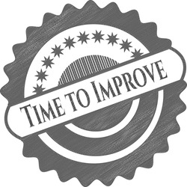



Areas of Strength
Has on-site service
Loyal to partners
Always looking to improve
Large Sales Capability & Specialty Products
Cooperation
Professional
Transparent Communication
Strong Product & Technical Knowledge
Notes:
(Q 43 – 44) Please list up to three areas where you feel Armour Valve is good or better than average.
Cooperation (work as a team) – strong designed
Professional – strong designed
Transparent Communication – Fusion Work, Strong designed
Strong Product & Technical Knowledge – Cosmic Engineering
Has on-site service -- Fusion Work
Loyal to partners – Radical steel
Always looking to improve – fusion work
Large Sales Capability & Specialty products– Fusion work
Radical Steel, Myriad Metal Works and Advanced Assembly did not respond.
Original:
specifications specialty products Always looking to improve
On site service Transparent communication Open for new
Professional Work as a team Loyalty to partners
Communikation Cooperation
Technical/product knowledge Overall sales capability

Slide 26
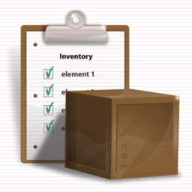







Areas for Improvement
Day-to-day business
Open up more business areas
Meet customer demands
More active participation – communication at every step
Inventory levels
On-site visits
Application & product knowledge
Marketing Client’s Products
Notes:
(Q 43 – 44) Please list up to three areas you would like to see improved at Armour Valve in order of importance.
Inventory levels – Cosmic Engineering
On-site visits -- Myriad (need someone to visit the office)
Application & product knowledge – Fusion Work (know how)
Marketing Client’s Products –- Radical ( someone to champion their product)
Day-to-day business – Radical
Open up more business areas -- Strong design
Meet customer demands – Weld Designed(concentrate on the the sector their interested in and expand in this sector --- Oil and Gas)
More active participation – communication at every step -- Fusion
QRC, Myriad Metal Works and Advanced Assembly did not respond.
Original:
the day to day business need someone from your office to visit have someone in your office be the champion for our products
Product know how Application know how
better consistency in not hesitating to communicate to us from whatever level or aspect more concentration on the sector that we are interested in; a pause on trying to expand from this sector with our product until we are getting everything we can out of the customers we have
Customer demands Product knowledge
New business areas
Inventory levels

Slide 27
Conclusion - Improvement
Prioritize in improving our relationship with Fusion Work and Modern Metals
Improve on communication virtually with Myriad Metal Works – Webinar, etc.
Respondents find it profitable to do business with us; Fusion Work disagrees
Strong design wants on-site person to person business
Strong design wants someone to champion their product
Notes:
Early engagement on supplier projects --- Add
Technical training on products for Radical Steel and Fusion Work

Slide 28
Conclusion - Improvement
Majority of respondents agree that AV has in-depth product knowledge – Fusion Work and Radical Steel partly disagree
More active participation with Advanced Assembly
Early engagement on supplier projects
Technical training on products for Radical Steel
Notes:
Early engagement on supplier projects --- Add
Technical training on products for Radical Steel and Fusion Work

Slide 29
Conclusion - Positives
Made all payments on time
AV keeps their commitments
Respondents say AV has clear contact and communication channel
All necessary information is shared in detail
All respondents agree that AV gives regular feedback

Slide 30
Conclusion - Positives
Product Quality was given the least feedback on; delivery accuracy, lead time and pricing were given the feedback on.
Employees are reliable and professional
AV represents products professionally
Supplier are focusing on Green Energy and Primary Markets

Slide 31
Thank you!

